Slide 1
Intergenerational Education Mobility in China
——Ke Zeng

Slide 2
Main Messages
The absolute mobility is around 0.7 nationally. The intergenerational education elasticity (IEE) is 0.45 or 0.46, depending on the measurement method.
Hukou (Household Registration System) have impact on the mobility. Hukou contributed 0.05 (which is 10%) of the elasticity increase.
IEE is leading in urban area. Volatility of IEE increases in recent period.

Slide 3
Methodology
Mobility measuring: absolute mobility & intergenerational mobility elasticity;
Education measuring: certificate matching;
Example: one with highest education of primary school certificate will be viewed as having 6 years;

Slide 4

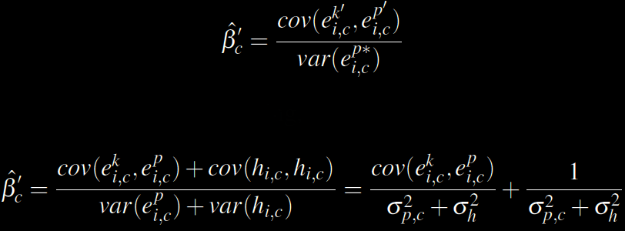


Methodology
$$e_{i,c}^{k}={β_{k}X}_{i,c}^{k}+h_{i,c}+u_{k}$$
$$e_{i,c}^{p}={β_{p}X}_{i,c}^{p}+h_{i,c}+u_{k}$$

Slide 5
Methodology
Variable | Obs | Mean | S.D. | Min | Max
Var_edu | 17,634 | 8.422508 | 4.198074 | 0 | 24
Var_f_edu | 13,512 | 4.964217 | 4.257895 | 0 | 24
Age(Ages2) | 17657 | 44.96 | 11.07 | 25 | 65
Gender | 17657 | 0.54 | 0.5 | 0 | 1
Hukou | 17657 | 0.82 | 0.89 | 0 | 1
Migration | 17649 | 0.79 | 0.41 | 0 | 1
Party | 17657 | 0.08 | 0.27 | 0 | 1
Log income | 12276 | 9.85 | 1.22 | 3.69 | 14.93

Slide 6
Result-absolute mobility
Absolute Mobility by Cohort
Cohort | Absolute mobility
- | 0.47
=<38 | 0.39
>38 | 0.49

Slide 7
Intergenerational elasticity
Intergenerational elasticity by Hukou and cohort
Hukou | Inter. Elasticity, =<38 | S.D. | Inter. Elasticity, >38 | S.D.
- | 0.29 | 0.02 | 0.21 | 0.01
Rural | 0.30 | 0.02 | 0.22 | 0.01
Urban | 0.26 | 0.03 | 0.17 | 0.02

Slide 8
Intergenerational elasticity
Intergenerational elasticity by regions and cohort
Regions | Inter. Elasticity, =<38 | S.D. | Inter. Elasticity, >38 | S.D.
Eastern | 0.29 | 0.02 | 0.18 | 0.01
Northeastern | 0.18 | 0.07 | 0.12 | 0.03
Central | 0.26 | 0.05 | 0.25 | 0.02
Western | 0.31 | 0.03 | 0.24 | 0.02

Slide 9


Hukou impact
$${\hat{β}}_{c}=\frac{cov(e_{i,c}^{k},e_{i,c}^{p})}{σ_{p,c}^{2}}$$
Estimated coefficients
Term | Value
$σ_{h}^{2}$-variance of Hukou | 0.14
$σ_{p,c}^{2}$-variance of parent education by cohort | 18.13

Slide 10

Hukou impact
Estimated Hukou effect $≅1/{\left(σ_{p,c}^{2}+σ_{h}^{2}\right)=\frac{1}{18.27}=0.05}$
Intergenerational elasticity from regression with/without Hukou control
Variable | (1) | S.D. | (2) | S.D.
Var_f_edu | 0.23 | 0.01 | 0.28 | 0.01
Hukou | -2.72 | 0.10 | - | -
Control variables | Yes | - | Yes | -
The difference of intergenerational elasticity is also 0.05.

Slide 11
What about decompose by year

Slide 12
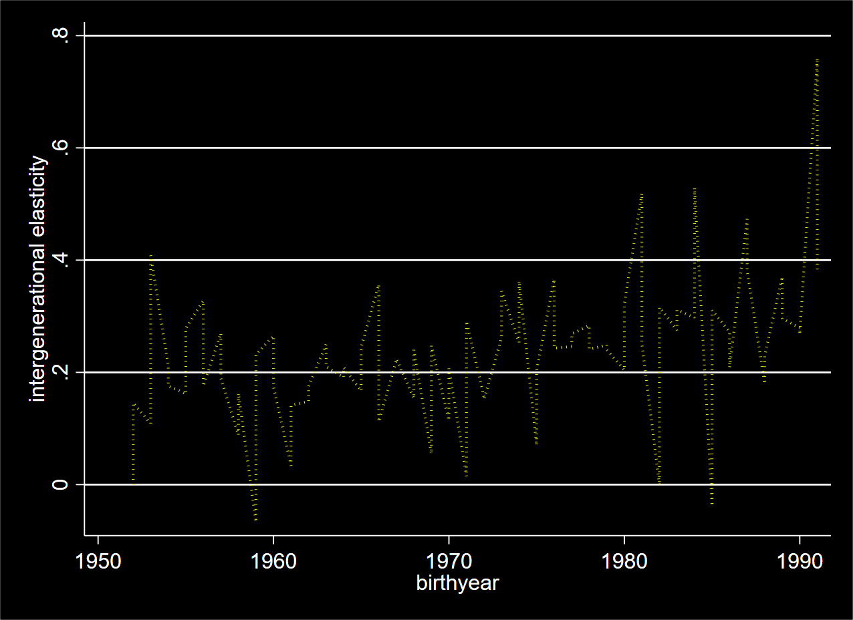

Slide 13
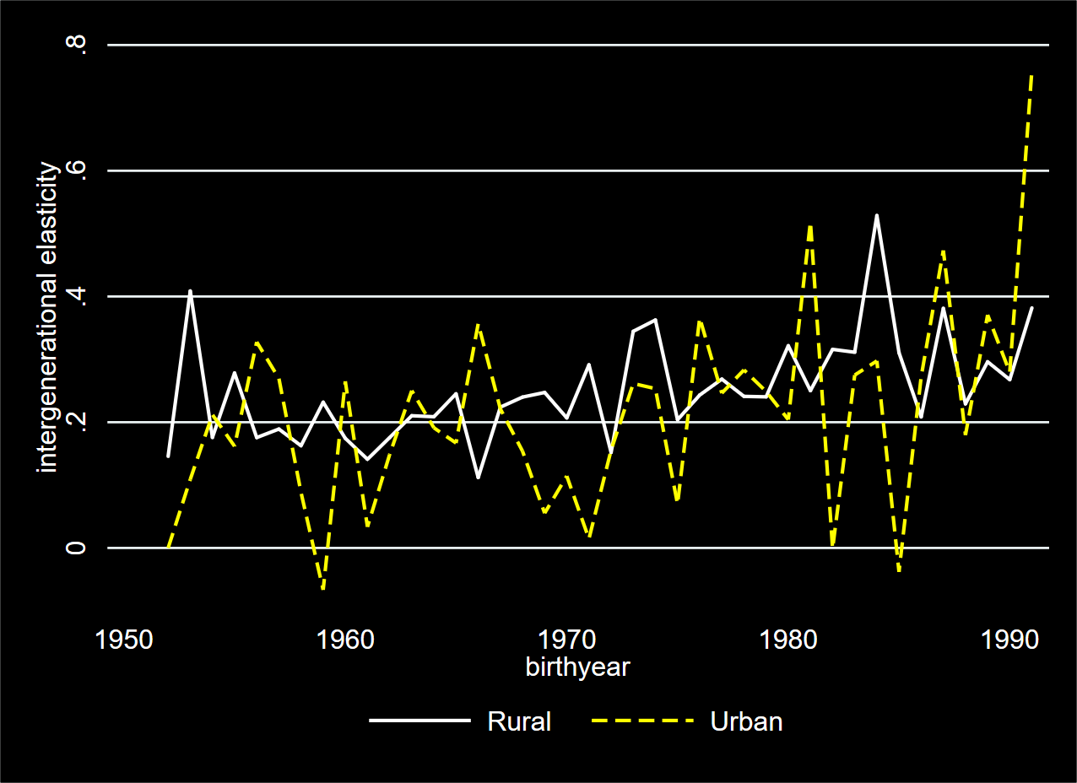

Slide 14
Beta by year
Two major characteristics
Intergenerational elasticity has been stable for people born before 1970s (around 0.2), and for the cohort born after 1978, the intergenerational elasticity has kept increasing (till 0.7 recently)
There is no much difference between rural and urban Hukou.
China held egalitarianism before reform 1978;
Access to education was decided by the hukou and other inherited factors.
The variance of elasticity was same at two periods (before and after)
Variance of Urban is larger than the variance of Rural.

Slide 15
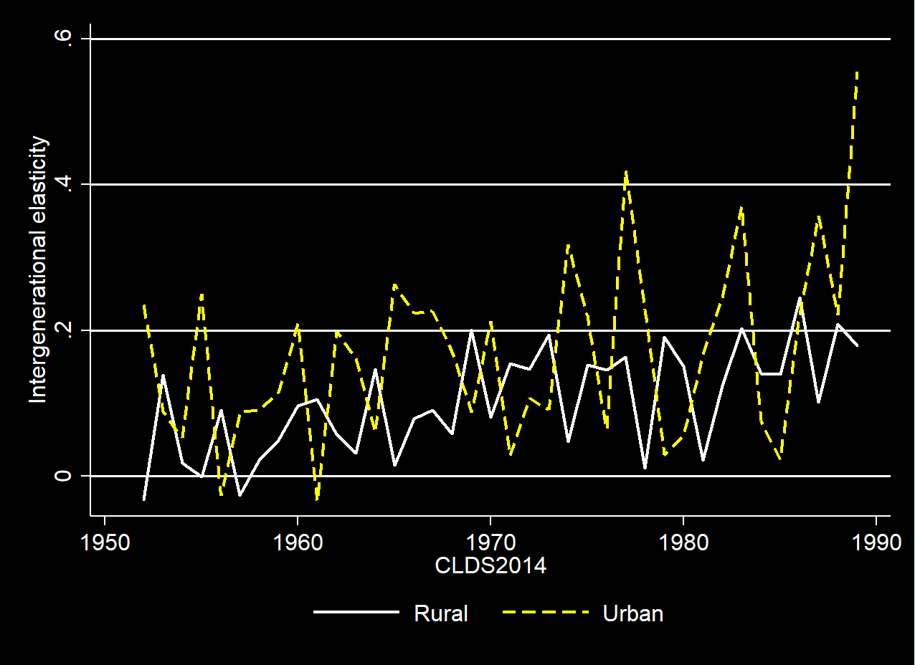

Slide 16
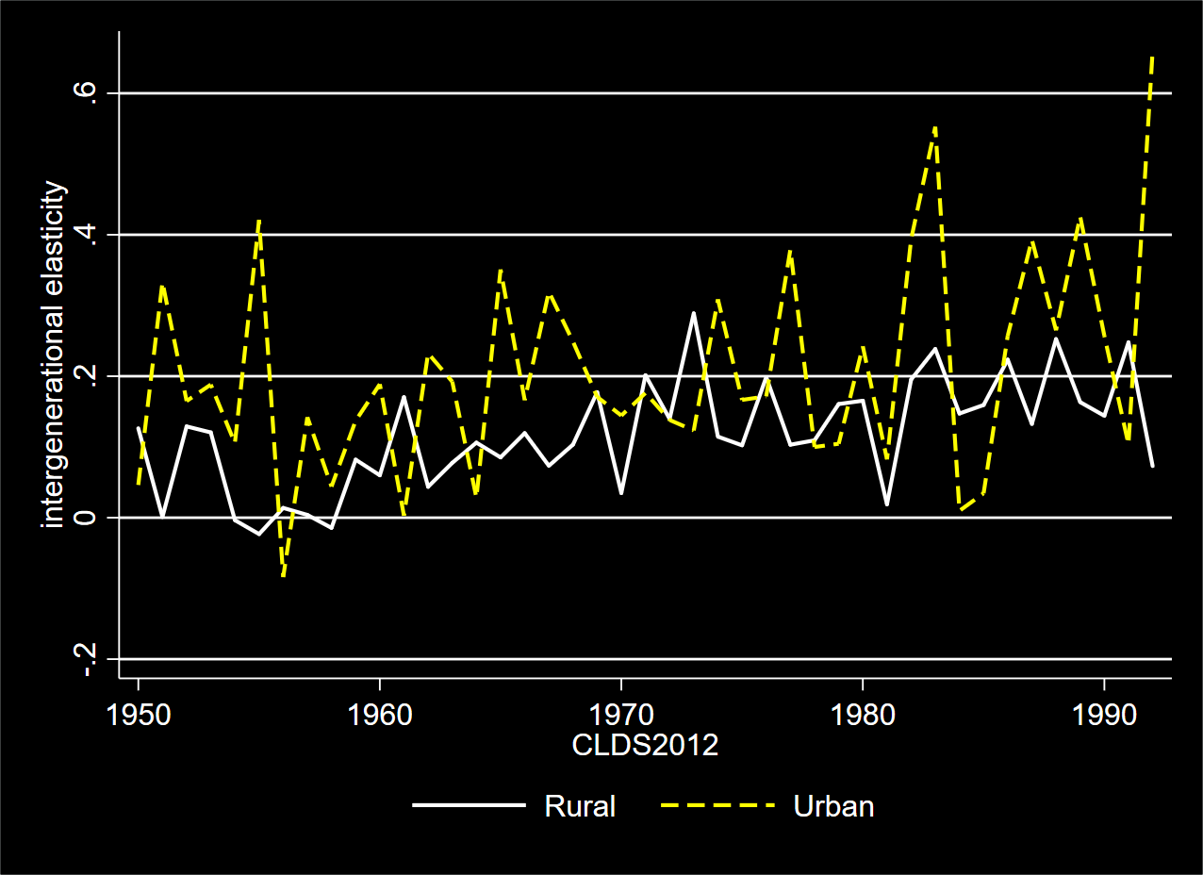

Slide 17
New questions
The inequality can be explained by the economical liberal reform after 1978, but why the variance fluctuated in such a way?
Does the reform in post-communism countries always increased the inequality? Why?

